Slide 1
San Francisquito Creek
SFCJPA.ORG
JOINT POWERS AUTHORITY
BOARD OF DIRECTORS MEETING
Via Video Call
April 23, 2020 at 3:30 p.m.

Slide 2
April 23, 2020 Board of Directors Meeting
Agenda Item 3:
APPROVAL OF BOARD MEETING MINUTES
March 26, 2020 Regular Board meeting

Slide 3
April 23, 2020 Board of Directors Meeting
Agenda Item 4:
PUBLIC COMMENT
Individuals may speak on any topic for up to three minutes; during any other Agenda item, individuals may speak for up to three minutes on the subject of that item.

Slide 4
April 23, 2020 Board of Directors Meeting
Agenda Item 5:
REGULAR BUSINESS – EXECUTIVE DIRECTOR’S REPORT
Consider approving the proposed Fiscal Year 2020-21 Operating Budget
Proposed Board action: approve Fiscal Year 2020-21 Operating Budget of revenues and expenses

Slide 5
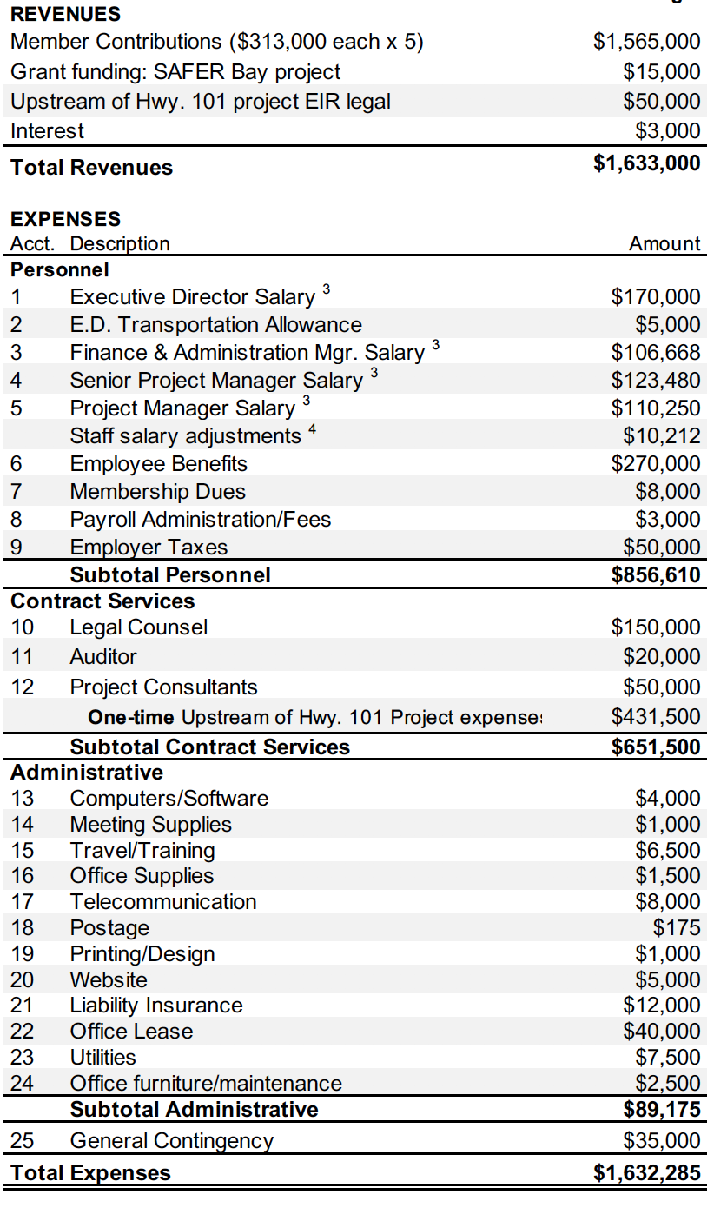
Proposed Fiscal Year 2020-21
Operating Budget Highlights
EXPENSES
One time for upstream of Hwy. 101 project – $400,000 for EIR for FEMA 100-yr protection, $31,500 arborist for City permits – $86K/agency
Legal: $150,000 for normal costs, EIR lawsuit and detention basin EIR
3% salary adjustment for staff
2% non-salary increase in personnel costs, 12% admin increase for IT & liability insurance
REVENUES
Each Member Agency contribution increase from $185K to $313K. ($128K increase = $86K for projects + $22K legal + $20K all other costs)
Grant overhead: $65,000. Remaining = $120,000
At end of FY20-21, reserves would equal about 17% of annual budget, or $200,000, a reduction of about $80,000 from 7/1/20. Policy on reserves recommended in 2010, but never approved.

Slide 6
SFCJPA Operating Reserves
Fiscal Year Total Approved Reserves % of Budget
Budget Amount
2013-14 $620,000 $93,000 15.0%
2014-15 $667,000 $93,000 13.9%
2015-16 $877,000 $93,000 10.6%
2016-17 $892,000 $170,000 19.0%
2017-18 $941,000 $170,000 18.0%
2018-19 $984,000 $180,000 18.2%
2019-20 $1,043,000 $185,000 17.7%
2020-21 $1,201,000* $200,000 16.6%
* April 23, 2020 proposed budget, not including one-time expenses

Slide 7
April 23, 2020 Board of Directors Meeting
Agenda Item 5:
REGULAR BUSINESS – EXECUTIVE DIRECTOR’S REPORT
Upstream of Highway 101 Project: Consider authorizing the Executive Director to execute a contract with Environmental Science Associates to develop a Mitigation and Monitoring Plan, restoration elements of the civil design, and a landscape design that are supported by regulatory agencies

Slide 8
Highlights of the proposed contract with ESA
PURPOSE: Enables development of key requirements of environmental permit applications: a Mitigation and Monitoring Plan, restoration elements of the civil design, and a landscape design for creek bank planting.
SCOPE OF WORK:
BUDGET: $99,500, paid for out of a funding agreement between the SFCJPA and Valley Water for Upstream of Highway 101 project environmental documentation
SCHEDULE:

Slide 9
April 23, 2020 Board of Directors Meeting
Agenda Item 5:
REGULAR BUSINESS – EXECUTIVE DIRECTOR’S REPORT
c. Consider approving Resolution 20.4.23 of the Board of Directors adopting the 2019 Update to the Bay Area Integrated Regional Water Management (IRWM) Plan

Slide 10
Adopt the 2019 Update to the Bay Area IRWM Plan
WHAT IS THE IRWM PLAN:
WHY DO WE NEED TO ADOPT IT:

Slide 11
April 23, 2020 Board of Directors Meeting
Agenda Item 6:
BOARD MEMBER MATTERS

Slide 12
April 23, 2020 Board of Directors Meeting
Agenda Item 7: CLOSED SESSION
Pursuant to Government Code Section 54957 regarding public employee performance evaluation - Title: Executive Director

Slide 13
April 23, 2020 Board of Directors Meeting
Agenda Item 8:
REGULAR BUSINESS
Delegate authority to sign SFCJPA documents and disbursements in the absence of an Executive Director

Slide 14
NEXT BOARD MEETING
May 28, 2020
3:30 p.m.
Location TBD

