Slide 1
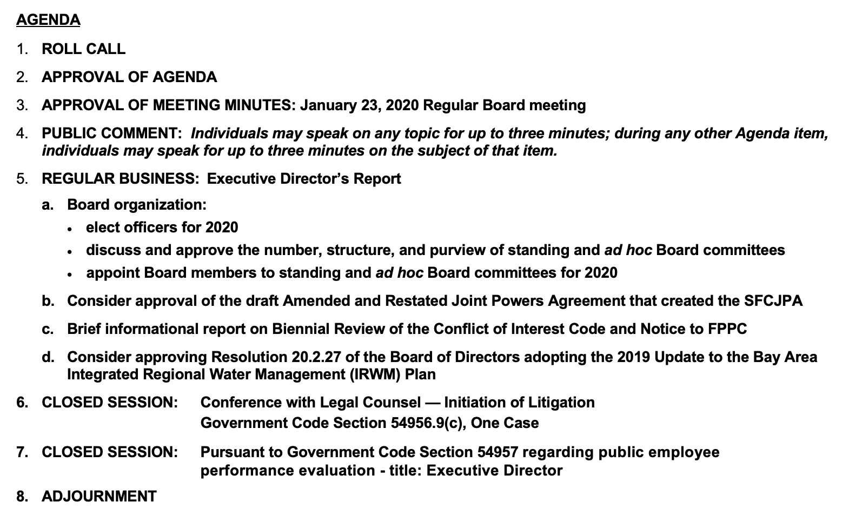
San Francisquito Creek
SFCJPA.ORG
JOINT POWERS AUTHORITY
SPECIAL BOARD OF DIRECTORS MEETING
East Palo Alto City Council Chambers
February 27, 2020 at 2:30 p.m.

Slide 2
February 27, 2020 Board of Directors Meeting
Agenda Item 3:
APPROVAL OF BOARD MEETING MINUTES
January 23, 2020 Regular Board meeting

Slide 3
February 27, 2020 Board of Directors Meeting
Agenda Item 4:
PUBLIC COMMENT
Individuals may speak on any topic for up to three minutes; during any other Agenda item, individuals may speak for up to three minutes on the subject of that item.

Slide 4
February 27, 2020 Board of Directors Meeting
Agenda Item 5:
REGULAR BUSINESS – EXECUTIVE DIRECTOR’S REPORT
a. Board organization:
elect officers for 2020
discuss and approve the number, structure, and purview of standing and ad hoc Board committees
appoint Board members to standing and ad hoc Board committees for 2020
Proposed Board action: Appoint a Chair and Vice Chair-Secretary; approve the number, structure, and purview of standing and ad hoc Board committees for 2020; and appoint members to those committees and representatives to the ACWA/JPIA.

Slide 5
Board Organization
2019 Board positions
Chair: Kremen Vice Chair: Abrica
Committees:
Finance: Pine & Kniss
Personnel: Abrica & Combs
Emergency Preparedness: Abrica & Kremen
Purposes, Roles and Responsibilities: Full Board
ACWA JPIA: Abrica (alternate Miyko Harris-Parker)
In 2020, add ad hoc committee on Exec. Dir. recruitment?

Slide 6
February 27, 2020 Board of Directors Meeting
Agenda Item 5:
REGULAR BUSINESS – EXECUTIVE DIRECTOR’S REPORT
Consider approval of the draft Amended and Restated Joint Powers Agreement that created the SFCJPA
Proposed Board action: Approve the enclosed draft Amended and Restated Joint Powers Agreement effective January 1, 2020 that created the SFCJPA and recommend sending it to the governing boards of all member agencies for approval.

Slide 7
Two-phased approach to update the Joint Powers Agreement
Attorneys from SFCJPA and member agencies met and agreed on amendments that did not involve policy questions. This Amended and Restated Joint Powers Agreement was included in the Board packet for today’s meeting. Following today’s meeting, it is planned that in March each member agency governing board will consider this revised Agreement.
Policy-related updates to the Agreement will be addressed in a second update brought to governing boards by the end of this fiscal year (June 30, 2020). Those updates may include changes to the sections describing SFCJPA purposes, powers, budget process, and indemnity.

Slide 8
Phase 1 (Feb. 2020) revisions: the low-hanging fruit
Change to recitals explaining history of SFCJPA and need for amending this Agreement.
Designate the Member Entity whose restrictions on the exercise of its powers apply to the SFCJPA.
Delete unnecessary text.
Allow for new members of the SFCJPA.
State that the SFCJPA Board cannot include two members from the same member agency governing body.
Specify: Board majorities and terms; operating budget income sources and approval milestone; insurance and controller requirements; process to amend Agreement; and indemnification of Board members, employees and agents.

Slide 9
Phase 2: have the Agreement reflect what we do & want to do
Update “Purposes” section to reflect what we do now, and what Board and the community want us to do:
protect against SF Creek and Bay flooding
enhance the environment, create recreational opportunities
provide emergency response info
secure resources to implement 1, 2, and 3
Update “Recitals” and “Powers” sections to reflect CA JPA law and standard language in JPA agreements, and make explicit JPA powers to fulfill “Purposes” section – including financing projects, issuing bonds, acquiring property by means other than donation, and hiring staff and legal counsel.

Slide 10
February 27, 2020 Board of Directors Meeting
Agenda Item 5:
REGULAR BUSINESS – EXECUTIVE DIRECTOR’S REPORT
c. Brief informational report on Biennial Review of the Conflict of Interest Code and Notice to FPPC

Slide 11
February 27, 2020 Board of Directors Meeting
Agenda Item 6: CLOSED SESSION
Conference with Legal Counsel — Initiation of Litigation
Government Code Section 54956.9(c), One Case
Agenda Item 7: CLOSED SESSION
Pursuant to Government Code Section 54957 regarding public employee performance evaluation - Title: Executive Director

Slide 12
NEXT BOARD MEETING
Thursday, March 26, 2020
3:30 p.m.
Palo Alto City Council Chambers

Slide 13
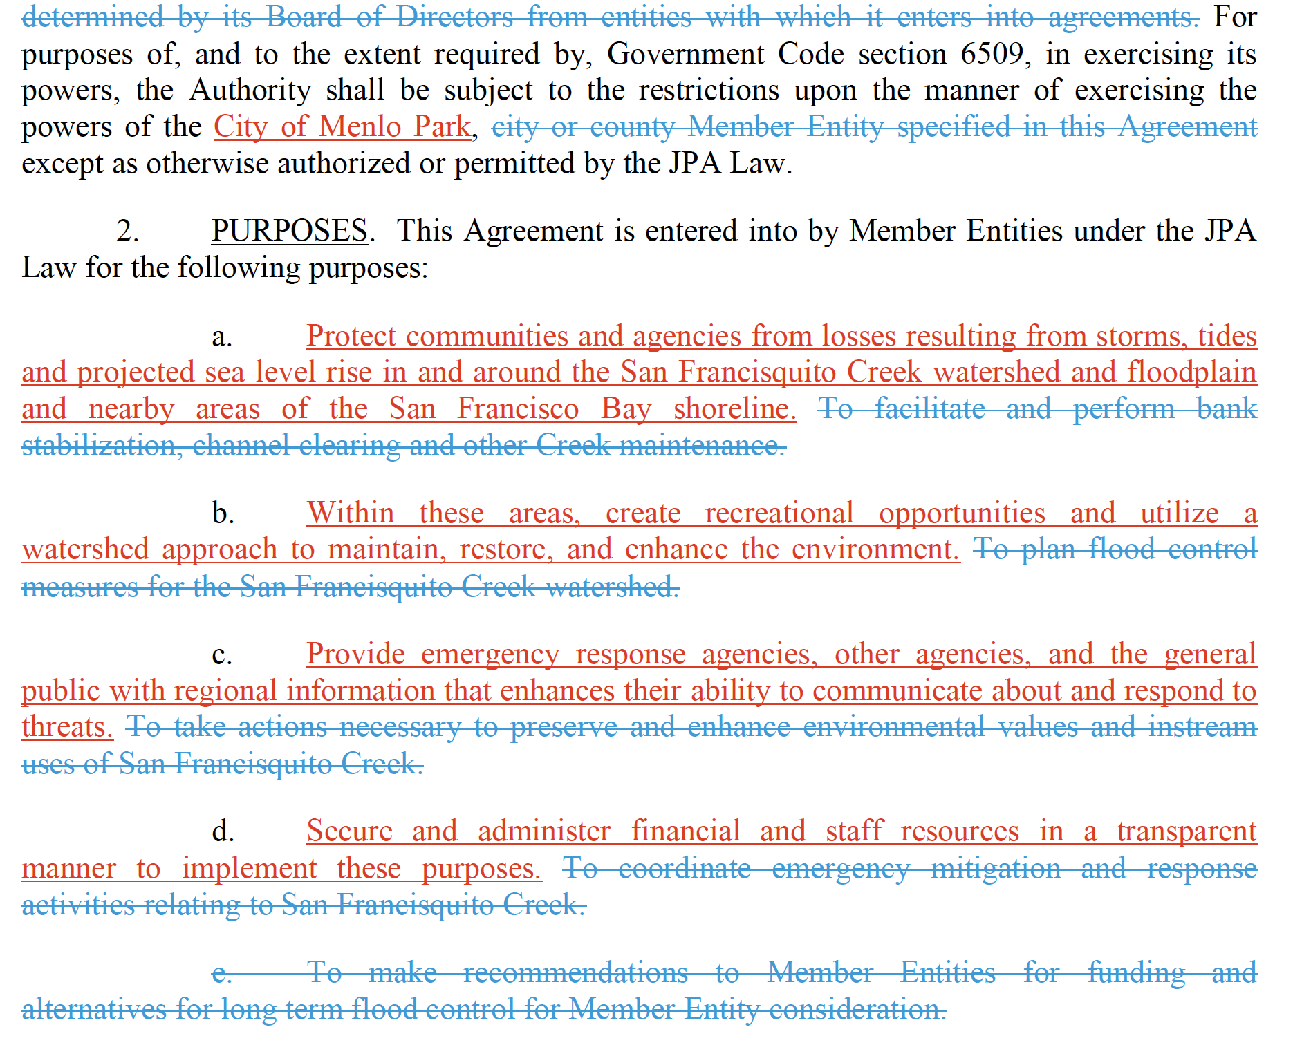

Slide 14
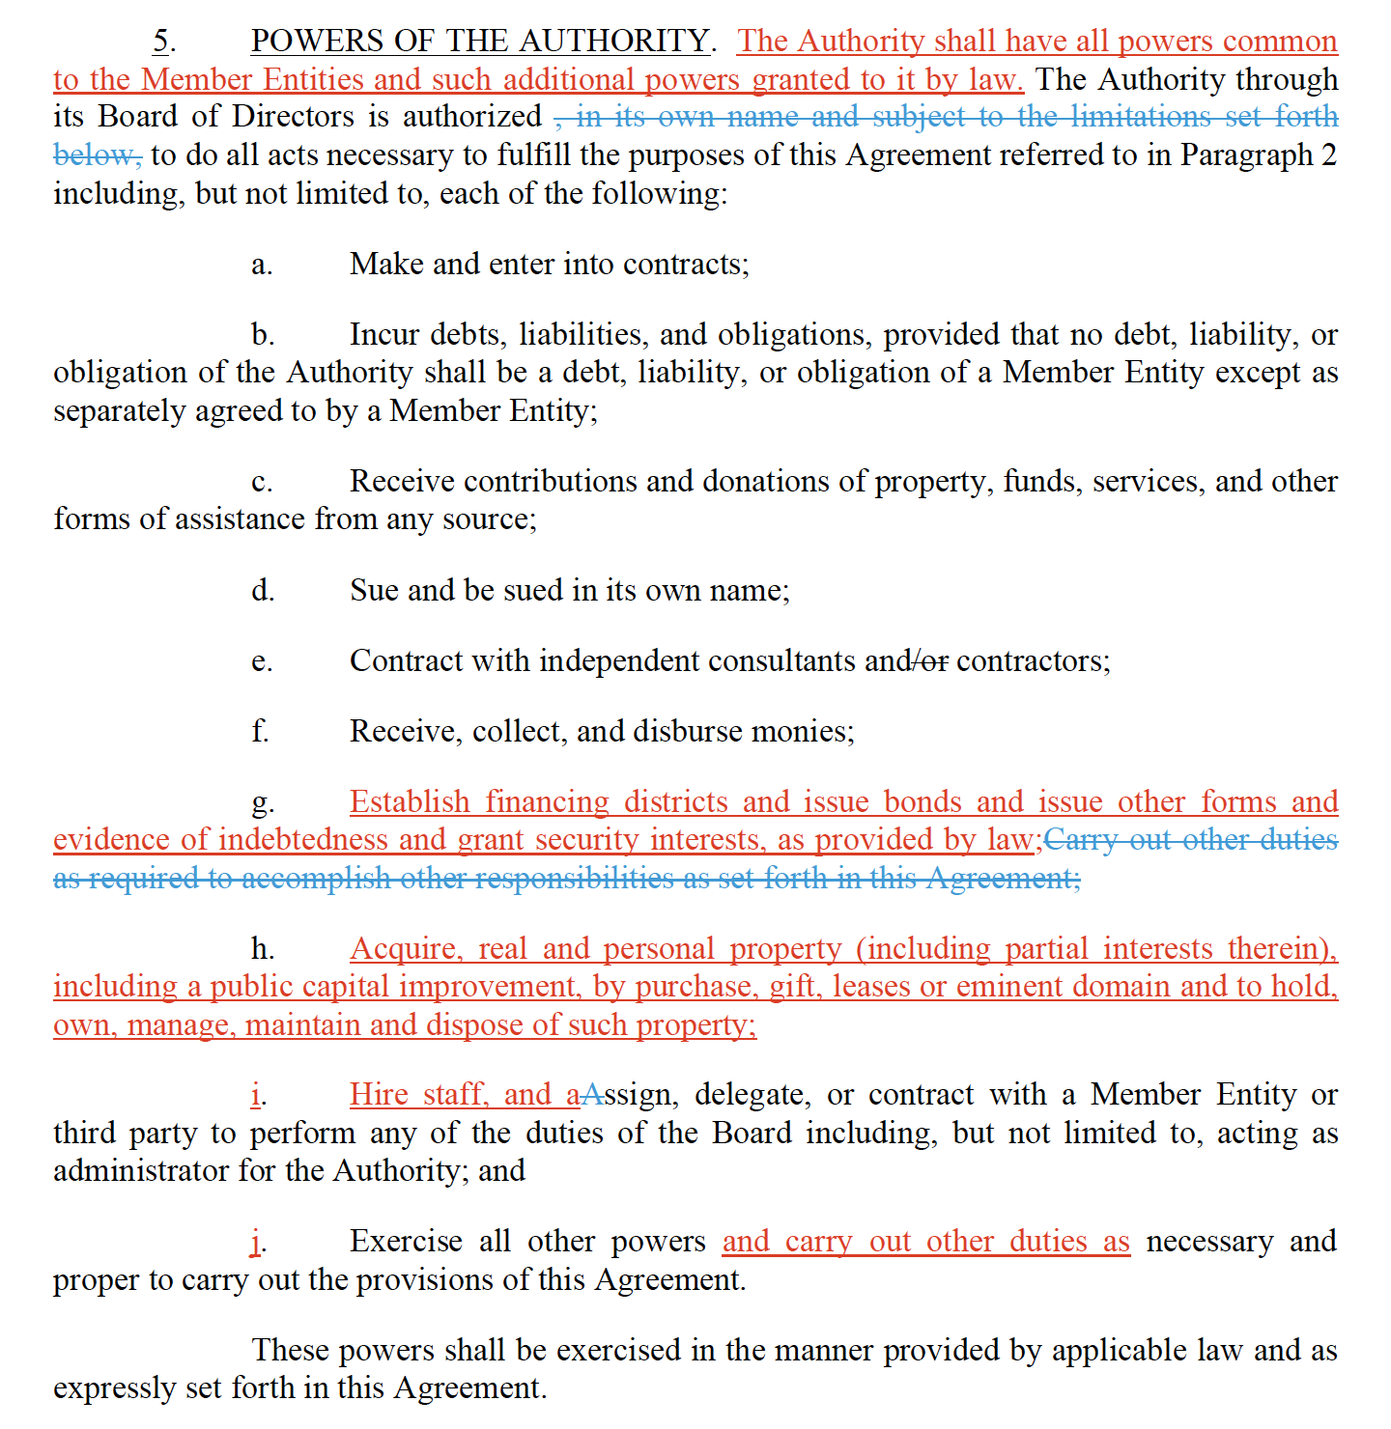

Slide 15
Dec. 2013 Retreat: Red Dots for each SFCJPA Responsibility
Long-term financing (16)
Project financial planning (14)
Grant writing and contracting (14)
Grant administration and reporting (13)
Project and funding agreements (13)
Enviro. documentation/CEQA process (13)
Early Warning System Upgrades (9)
Resource conservation (7)
Regional efforts (IRWMP, Stanford, etc) (6)
Creek maintenance and resident coord. (5)
Restoration and recreation planning (5)
Corps of Engineers interactions (5)
Federal engagement (5)
Water quality monitoring (5)
Land use coordination in watershed (5)
Regional regulatory forum (3)
Permitting (3)
Channel inspection and maintenance (3)
Debris removal – winter prep or emergency (2)
Caltrans coordination (2)
Consultant contracting and invoicing (1)
Civil design contracting and review (0)
Real estate acquisition (0)
Utilities planning and contracting (0)
Trash removal (0)
Homeless encampments (0)
Invasive plant control (0)
Bank stabilization homeowner assistance (0)

